Slide 1
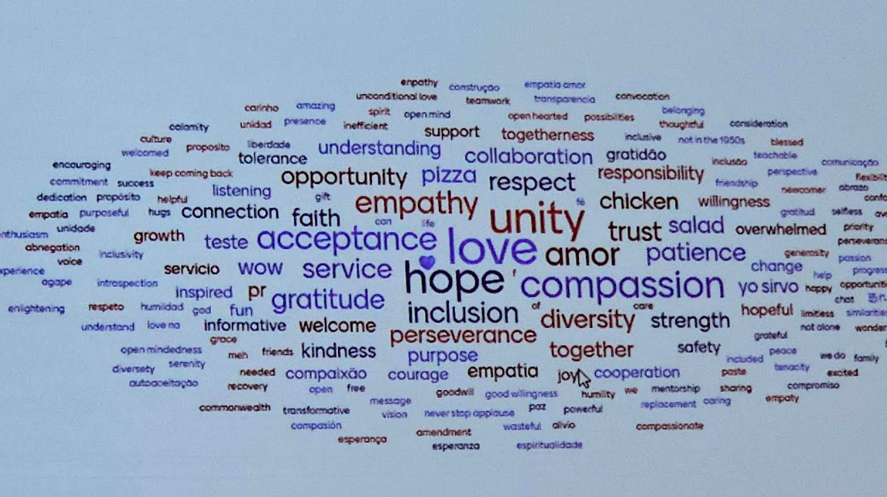
WSC 2026: OUR COMMON WELFARE
Notes:
World Service Conference 2026 — Report to the CARNA Region
It was the honor of my recovery to represent CARNA at the 2026 World Service Conference. Gathered under the theme “Our Common Welfare,” the week reminded me that our First Tradition is not an abstraction — it is the living agreement that keeps our fellowship whole.
I came home changed: more grounded in our primary purpose, clearer about where we are headed, and carrying renewed energy and a deepened commitment to serve our region. This report captures what I witnessed, what moved me personally, and what I am bringing back to CARNA.

Slide 2
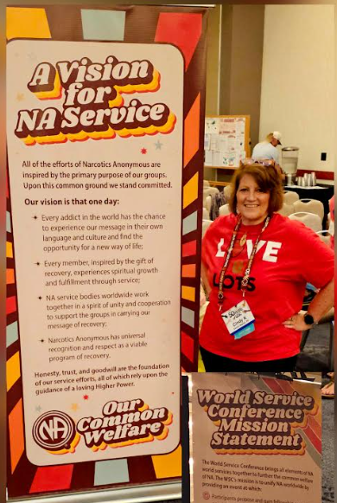
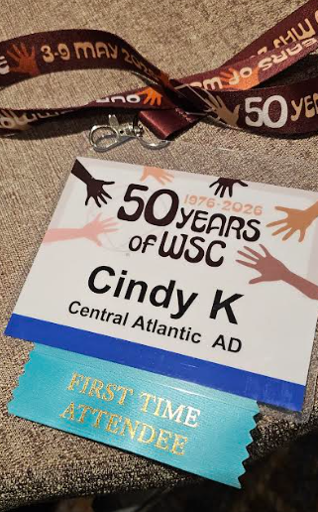
Honored, blessed and grateful to carry the conscience and voice of our region.
Notes:
Global attendance and unity. Carrying the conscience and voice of our region was a profound responsibility. Sitting among delegates from around the world, I felt the unity of a worldwide fellowship that shares one primary purpose — to carry the message to the addict who still suffers.
Despite different languages, cultures, and customs, we were undeniably one. That sense of shared welfare — that what helps one region ultimately helps us all — set the tone for everything that followed and is the spirit I want to carry home to CARNA.

Slide 3
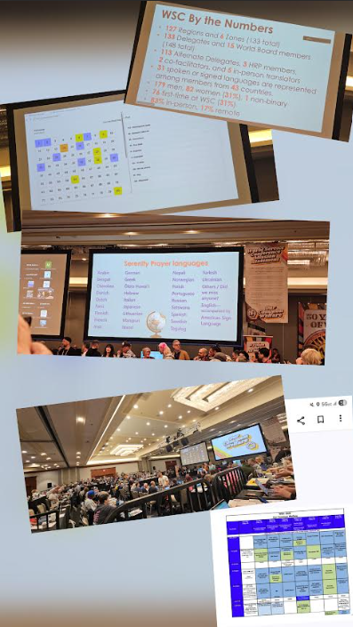
Opening in with Serenity Prayer in over 35 languages.
FULL Schedule Sat – Sat
POV from the risers.
How the queue works
WSC by the numbers : 127 regions and 6 zones
Notes:
One fellowship, one conscience. Opening the conference with the Serenity Prayer spoken in over 35 languages is something I will never forget — it was the sound of unity itself.
From the risers, the full Saturday-to-Saturday schedule and the scale of the gathering came into focus: WSC by the numbers — 127 regions and 6 zones represented. Learning how the queue and floor process works gave me real appreciation for how a fellowship this large still moves as one body and one conscience.

Slide 4
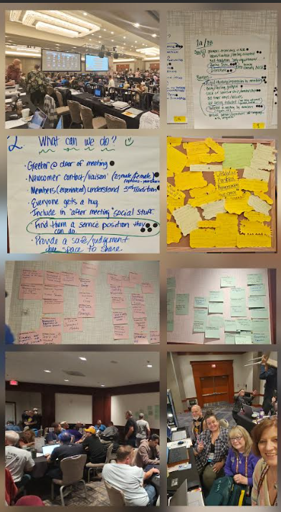
Breakout sessions were the best!
Strategic planning collaboration prioritizing needs/goals
We all have similar opportunities and challenges
Shared ‘accomplishments’ and service wins
Notes:
Working in small groups. The breakout sessions were the best part of the week. Working in small groups with ADs from other countries and from across the United States, we did the real work of service — strategic planning, prioritizing needs and goals, and sharing our service successes and wins.
What struck me most was how similar our opportunities and challenges are, no matter where we serve. We traded practical solutions, celebrated one another’s accomplishments, and left with concrete ideas to help our fellowship grow and further carry the message in CARNA.

Slide 5
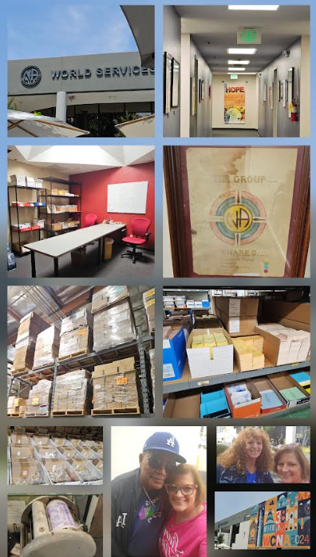
World Service Office, lunch and tour.
Jimmy K Logo
H&I room
Tons of literature in tons of languages.
Loads of keytags, medallions and IPs
Tons of historical documents and global memorabilia
Notes:
Meeting the World Board and NAWS staff. The visit and tour of the World Service Office brought our global structure to life — the H&I room, the Jimmy K logo, shelves of literature in dozens of languages, keytags, medallions, IPs, and the historical documents and memorabilia that hold our story.
Meeting and interacting with the World Board and NAWS staff was a personal highlight. They were approachable, humble, and clearly servants first. Putting faces and real conversations to the names behind our literature and services deepened my trust in our world services and my understanding of how much dedicated work supports our message.

Slide 6
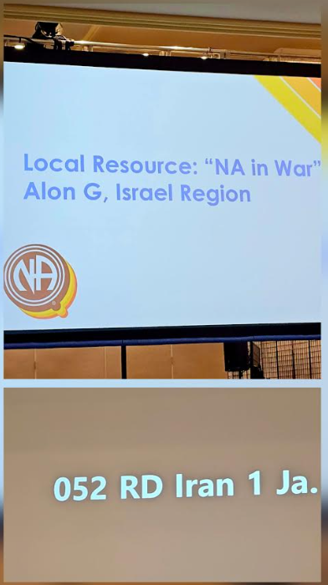
This sums up NA “as such” and brought me to tears…
Notes:
Decision-making: success and challenge. The moment that summed up NA “as such” brought me to tears — it captured exactly why we do this work. On the business of the conference, there was real success, and there were challenges as we worked through new processes.
Even so, the Consensus-Based Decision Making (CBDM) process proved to be both efficient and fair, giving every region a genuine voice while allowing us to move forward together.
Bringing it home. I return to CARNA with new insight, renewed energy, and a firm commitment to serve — to share what I learned, support our trusted servants, and help us further carry the message. Honored, blessed, and grateful.

